Slide 1
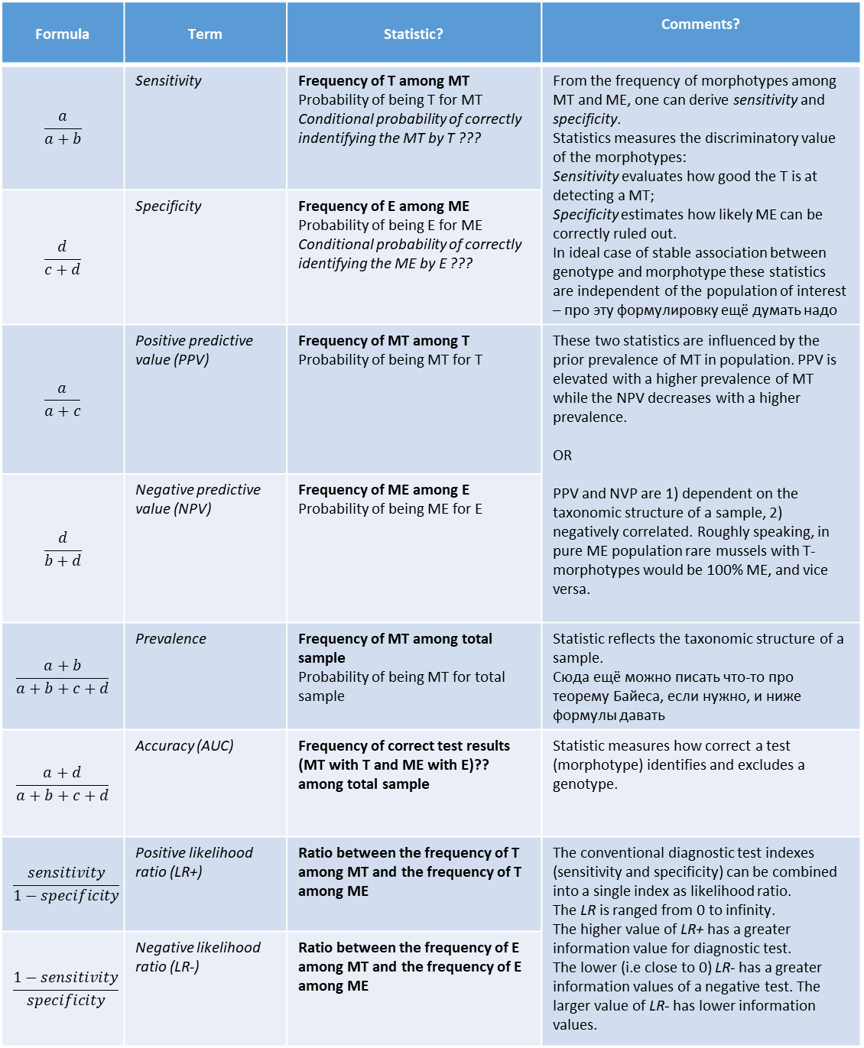
Morphotype (test results) | Genotype (true status)
 | МТ | МЕ
Т | a | c
E | b | d
Надо ли писать что-то подобное?
Conventionally, a standard way of describing the accuracy of a diagnostic test is the two-by-two table. This is performed when the test results are recorded as dichotomous outcomes (positive (T) / negative (E) results). As table shows, the column represents the true status of species that is assessed without errors by genotype.
ЕЩЁ НЕ СДЕЛАЛА
Добавить сюда оценки для всех трёх выделов
Где нет чисел – пишем функцию
Formula | Term | Statistic? | Comments?
$$\frac{a}{a+b}$$ | Sensitivity | Frequency of T among MT Probability of being T for MT Conditional probability of correctly indentifying the MT by T ??? | From the frequency of morphotypes among MT and ME, one can derive sensitivity and specificity. Statistics measures the discriminatory value of the morphotypes: Sensitivity evaluates how good the T is at detecting a MT; Specificity estimates how likely ME can be correctly ruled out. In ideal case of stable association between genotype and morphotype these statistics are independent of the population of interest – про эту формулировку ещё думать надо
$$\frac{d}{c+d}$$ | Specificity | Frequency of E among ME Probability of being E for ME Conditional probability of correctly identifying the ME by E ???
$$\frac{a}{a+c}$$ | Positive predictive value (PPV) | Frequency of MT among T Probability of being MT for T | These two statistics are influenced by the prior prevalence of MT in population. PPV is elevated with a higher prevalence of MT while the NPV decreases with a higher prevalence. OR PPV and NVP are 1) dependent on the taxonomic structure of a sample, 2) negatively correlated. Roughly speaking, in pure ME population rare mussels with T-morphotypes would be 100% ME, and vice versa.
$$\frac{d}{b+d}$$ | Negative predictive value (NPV) | Frequency of ME among E Probability of being ME for E
$$\frac{a+b}{a+b+c+d}$$ | Prevalence | Frequency of MT among total sample Probability of being MT for total sample | Statistic reflects the taxonomic structure of a sample. Сюда ещё можно писать что-то про теорему Байеса, если нужно, и ниже формулы давать
$$\frac{a+d}{a+b+c+d}$$ | Accuracy (AUC) | Frequency of correct test results (MT with T and ME with E)?? among total sample | Statistic measures how correct a test (morphotype) identifies and excludes a genotype.
$$\frac{sensitivity}{1−specificity}$$ | Positive likelihood ratio (LR+) | Ratio between the frequency of T among MT and the frequency of T among ME | The conventional diagnostic test indexes (sensitivity and specificity) can be combined into a single index as likelihood ratio. The LR is ranged from 0 to infinity. The higher value of LR+ has a greater information value for diagnostic test. The lower (i.e close to 0) LR- has a greater information values of a negative test. The larger value of LR- has lower information values.
$$\frac{1−sensitivity}{specificity}$$ | Negative likelihood ratio (LR-) | Ratio between the frequency of E among MT and the frequency of E among ME

